Slide 1
Visual Studio project files for EPICS
Peter Heesterman
Peter.Heesterman@Ukaea.Uk
Peter.Heesterman@Tessella.com

Slide 2



Why do this?
Use the VS developer environment natively.
‘Comfort zone’ for a Windows developer.
Can build, search and debug code easily.
Access to a wide range of developer tools.
Suitable for ‘leading edge’ work.
Triggers:
Build EPICS v4 on Windows – I was then unused to working with makefiles.
Recently, the areaDetector ADURL module.

Slide 3
Methodology
Reverse engineered the EPICS build by inspection of the build logs.
C and C++ code is easy – it only needs the relevant pre-processor defines:
EPICS_CALL_DLL and EPICS_BUILD_DLL for DLL builds with base 3.15.
EPICS_DLL_NO for static builds with base 3.14.

Slide 4
Custom build tools
Consists of:
Custom build commands, e.g. Perl scripts.
dbdToRecordTypeH, dbdToMenuH, dbdExpand, etc.
Internally-built build tools
Antelope.exe (yacc, Yet Another Compiler Compiler)
E_flex.exe (a lexical scanner).
Header and DBD files are copied.
cd db
SET PERL5LIB=$(SolutionDir)lib\perl
perl -CSD $(OutDir)dbdToRecordtypeH.pl -o ../O.Common/dbCommon.h %(FileName).dbd
cd $(ProjectDir)

Slide 5
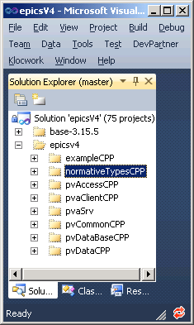
Supported modules
Base.
Asyn.
Autosave, busy, calc, ipac, seq, sscan.
areaDetector ADCore, ADSupport and ADURL.
EPICS v4.

Slide 6
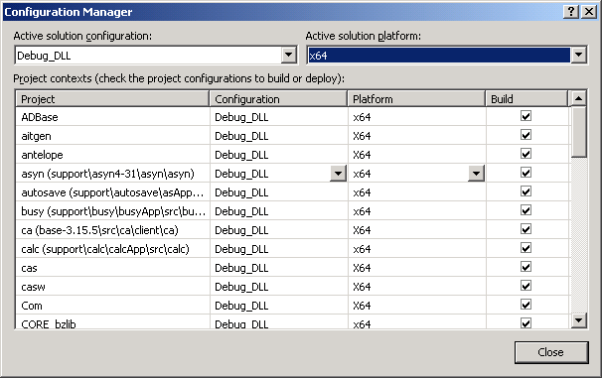
Build configurations
8 possible combinations:
Debug / Release
DLL / Static
x86 / x64

Slide 7
See what you think
Available from https://github.com/ukaea/epics.git
Feedback would be very welcome.
Demonstration if there is time, else after the meeting.
Any questions?

Slide 8

If you like it…

